Slide 1
Energy and Water Balance
September 17, 2019

Slide 2
Pre-class ice breaker → write down your answer
Are urban areas cooler than close-by rural areas? Why or why not?
Why are polar areas warming at a faster rate than equatorial areas?
Why are greenhouse gases warming the Earth?

Slide 3
The surface energy budget

Slide 4
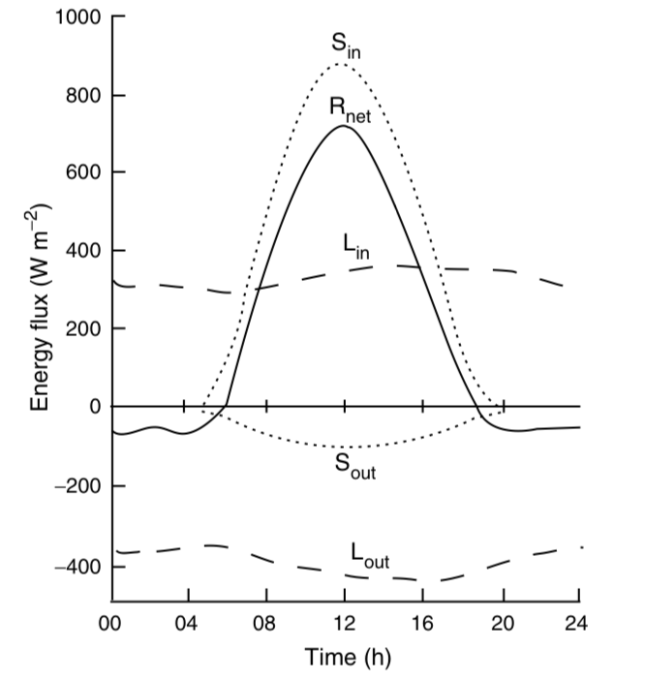
The net radiation absorbed by a surface is a sum of ingoing and outgoing radiation
K
K

Slide 5
The net radiation absorbed by a surface is a sum of ingoing and outgoing radiation
K
R_{net} = (K_{in} – K_{out}) + (L_{in} – L_{out})
K

Slide 6
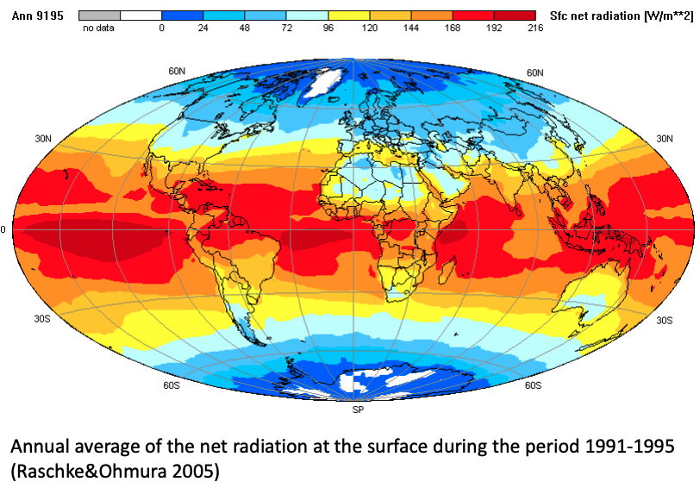
R_{net}

Slide 7
Shortwave (K) depends on the albedo (α)
K
R_{net} = (K_{in} – K_{out}) + (L_{in} – L_{out})
R_{net} = (1– α)K_{in} + (L_{in} – L_{out})
K

Slide 8
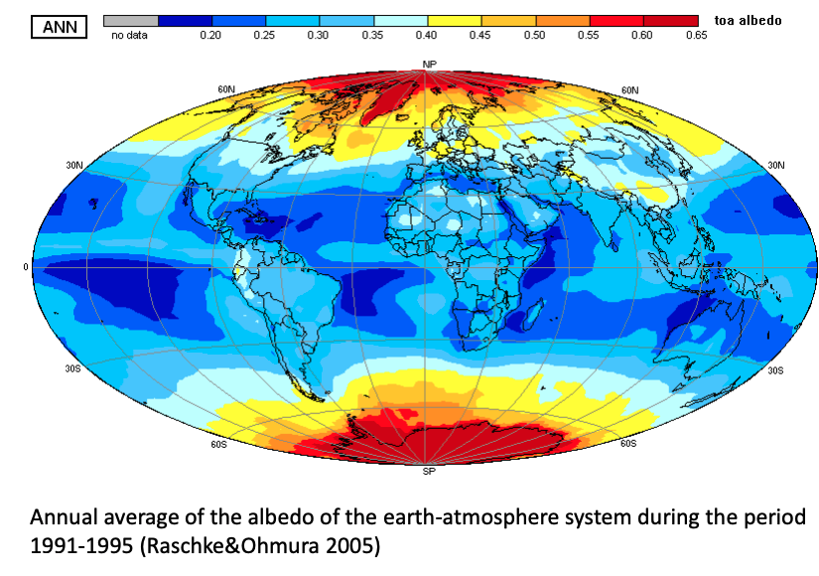
α

Slide 9
Longwave (L) depends on temperature (T)
K
R_{net} = (K_{in} – K_{out}) + (L_{in} – L_{out})
R_{net} = (1– α)K_{in} + (L_{in} – L_{out})
R_{net} = (1– α)K_{in} + (L_{in} – L_{out})
L_{in} = σε_{sky}T_{sky}⁴
L_{out} = σε_{surface}T_{surface}⁴
ε = emissivity
σ = Stefan-Boltzman constant
K

Slide 10
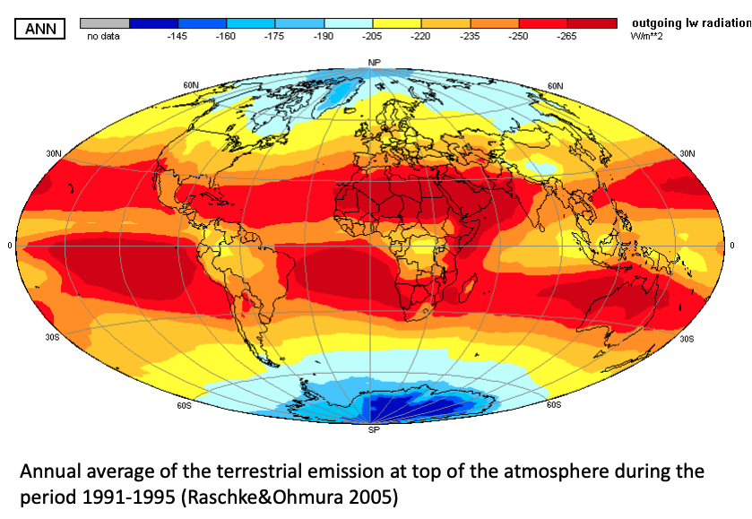
L_{out}

Slide 11
Net radiation (R_{net}) is partitioned into different fluxes at the surface
R_{net} = H + LE + G + ∆S

Slide 12
Net radiation (R_{net}) is partitioned into different fluxes at the surface
R_{net} = H + LE + G + ∆S
Total radiation absorbed by the surface

Slide 13
Net radiation (R_{net}) is partitioned into different fluxes at the surface
R_{net} = H + LE + G + ∆S
Sensible heat flux (heat transfer without phase change)

Slide 14
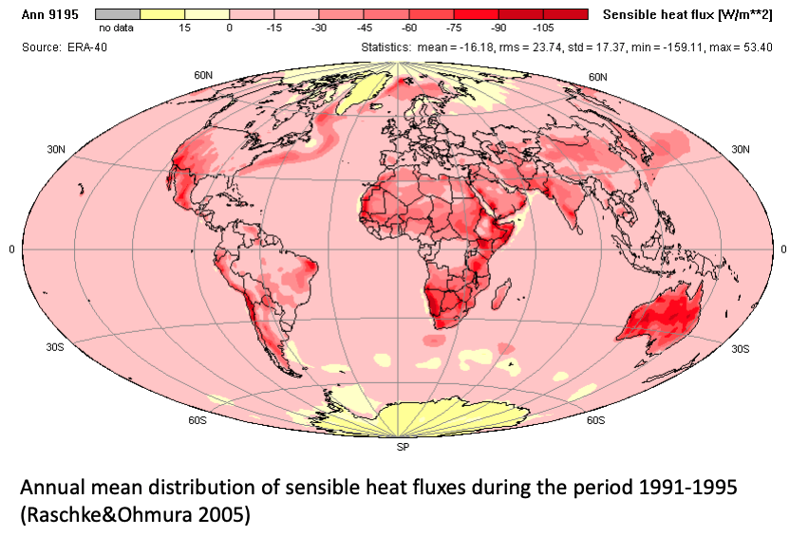
H

Slide 15
Net radiation (R_{net}) is partitioned into different fluxes at the surface
R_{net} = H + LE + G + ∆S
Latent heat flux (heat transfer with phase change)
L = latent heat of vaporization (constant)
E = evapotranspiration

Slide 16
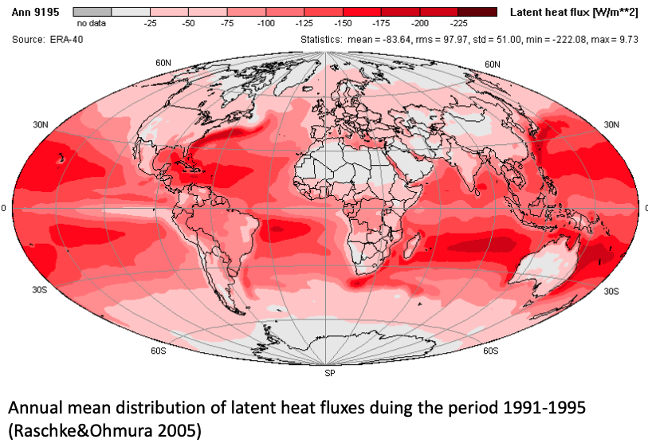
LE

Slide 17
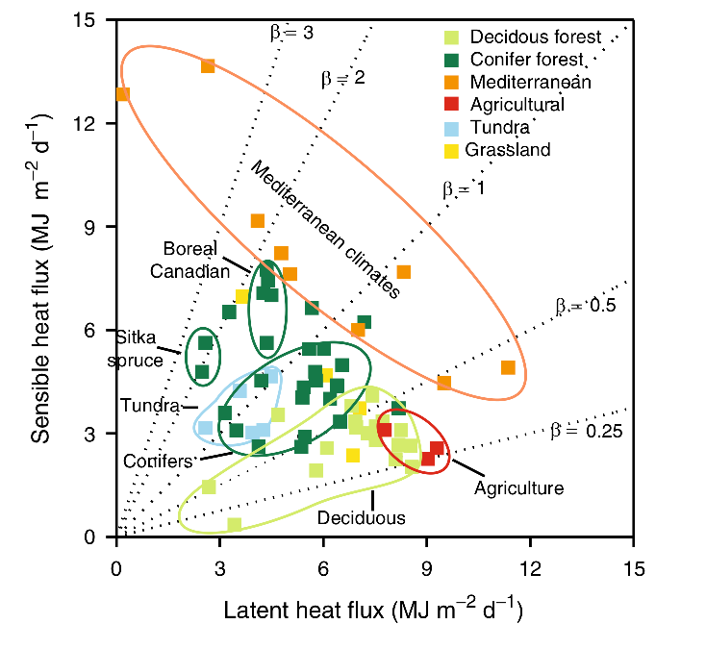
Bowen ratio – ratio of sensible (H) to latent (LE) heat flux (H/LE)
What do you notice from this figure?

Slide 18
Bowen ratio – ratio of sensible (H) to latent (LE) heat flux (H/LE)
Low transpiration/ Dry ecosystems
High transpiration/Wet ecosystems

Slide 19
Bowen ratio – is spatially and temporally variable
Desert - High
Spatial – turbulence within and between ecosystems
Temporal – snowmelt, bud break
Tropical Rainforest – Low
Tight linkage of energy and water budgets

Slide 20
Net radiation (R_{net}) is partitioned into different fluxes at the surface
R_{net} = H + LE + G + ∆S
Ground heat flux (small flux of energy from soils)

Slide 21
Net radiation (R_{net}) is partitioned into different fluxes at the surface
R_{net} = H + LE + G + ∆S
Storage

Slide 22
Now that we have R_{net} in two equations, we can build a full energy budget equation

Slide 23
Class activity → turn in for participation point
Solve the surface energy budget for T_{surface}
Answer the beginning of class questions using your equation:
Are urban areas cooler than close-by rural areas? Why or why not?
Why are polar areas warming at a faster rate than equatorial areas?
Why are greenhouse gases warming the Earth?

Slide 24
Surface energy budget recap
Important biological characteristics
Albedo
Transpiration (latent heat flux)
Coupling with terrestrial water cycles
Influences atmospheric water demand
Influences atmospheric water storage

Slide 25
Surface energy budget recap
Important biological characteristics
Albedo
Transpiration (latent heat flux)
Coupling with terrestrial water cycles
Influences atmospheric water demand
Influences atmospheric water storage

Slide 26
Half-baked climate solutions!
Idea: open up stomata to crank up photosynthesis to increase carbon uptake
Would this impact climate?
Openness of stomata
Photosynthesis
Medlyn et al. (2011)

Slide 27
Higher photosynthesis
Smith et al. (2017)

Slide 28
Higher photosynthesis
More latent heat flux
Smith et al. (2017)

Slide 29
More latent heat flux
Local cooling
Smith et al. (2017)

Slide 30
Water budget

Slide 31
Questions
How does water enter a terrestrial ecosystem?
Where does it go?
Outputs
Storage

Slide 32
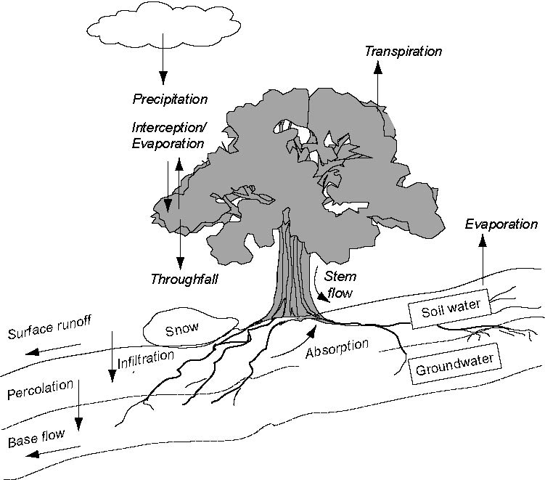

Slide 33
The Water Budget Precipitation +/- Storage = Evapotranspiration + Runoff

Slide 34
The Water Budget P +/- ∆S = E + R

Slide 35
The Water Budget P = E + R +/- ∆S

Slide 36
Water moves through ecosystems via potential gradients

Slide 37
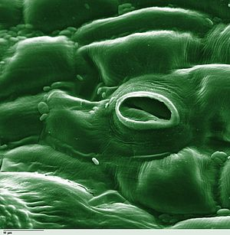
Water moves from high water potential to low water potential via a continuous water column/film

Slide 38
Remember: soil water potential depends on soil texture

Slide 39
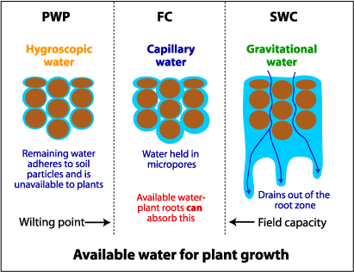

Slide 40
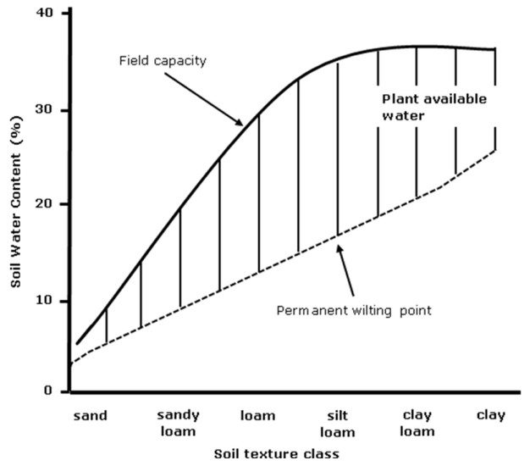

Slide 41
Coupling to the energy budget: Transpiration

Slide 42
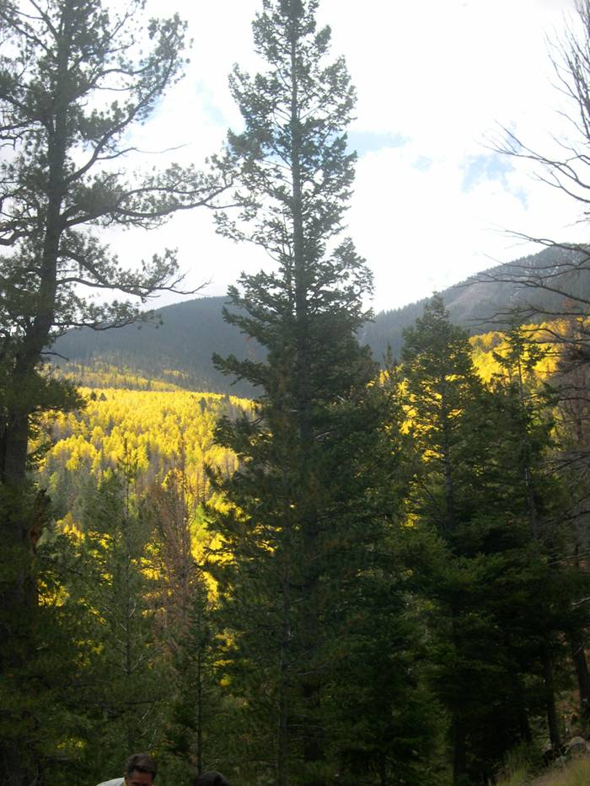
Transpiration is positively related to soil water availability…
(Fischer et al. 2003 Tree Phys.)

Slide 43
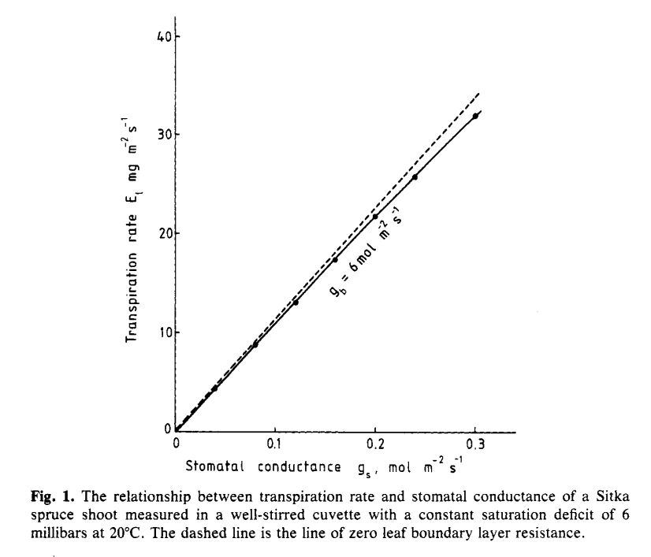
…and stomatal opening…
Jarvis and McNaughton (1986)

Slide 44
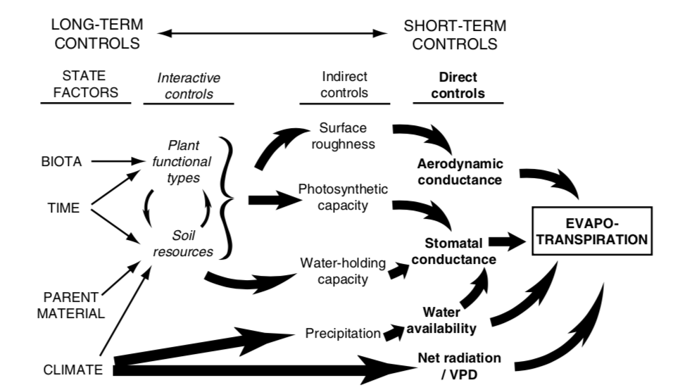
…and a lot of other things!

Slide 46
How does transpiration respond to…
Higher temperatures?
Reduced humidity?
Higher light?
Higher CO₂?

Slide 47
Side bar: Why are there more clouds over the vegetation?

Slide 48
Plant water movement varies by ecosystem due to differential species responses: Isohydry

Slide 49
Isohydry
Isohydric species are sensitive to changes in water availability, quickly closing their stomata in response to drought
Drought avoiders
Maintain high Ψ
Anisohydric species tend to respond more slowly to drought
Drought tolerators
Tolerate low Ψ

Slide 50
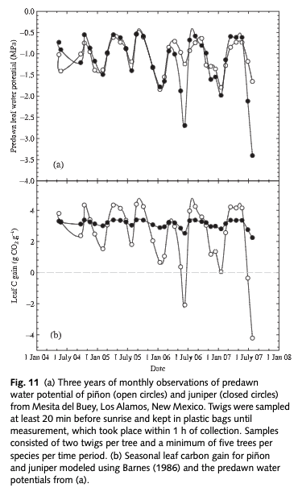
McDowell et al. (2008)

Slide 51
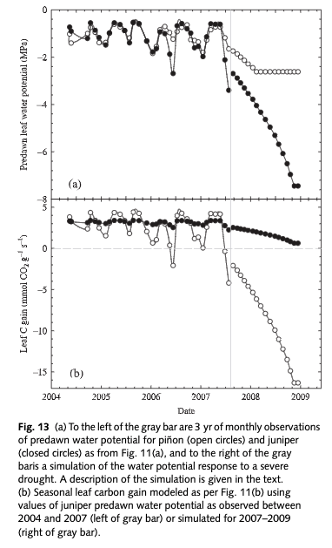
McDowell et al. (2008)

Slide 52
How would isohydry strategy influence the water cycle?

Slide 53
The Water Budget Precipitation +/- Storage = Evapotranspiration + Runoff

Slide 54
The Water Budget Precipitation +/- Storage = Evapotranspiration + Runoff

Slide 55
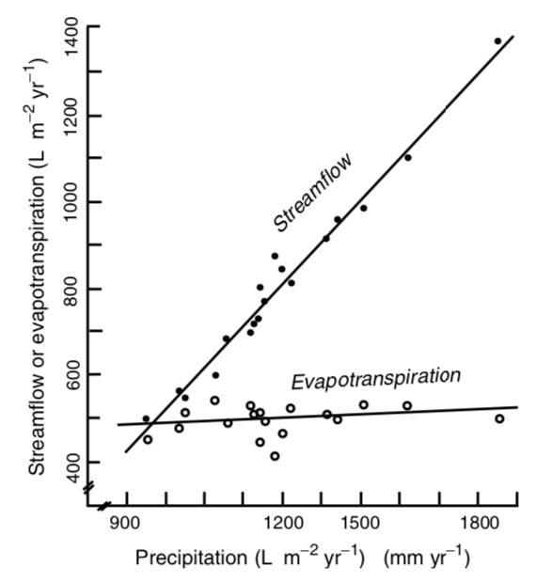
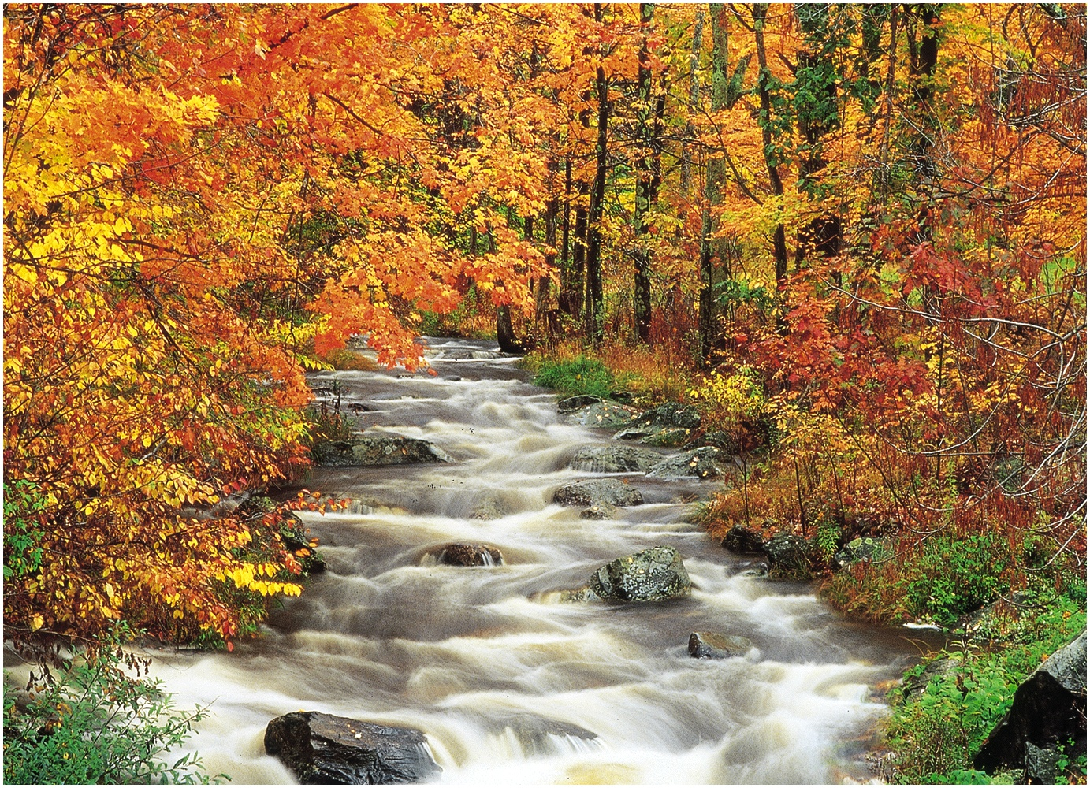
P + ∆S = E + R
P = Precipitation
S = Storage
E = Evapotranspiration
R = Runoff (streamflow)

Slide 56
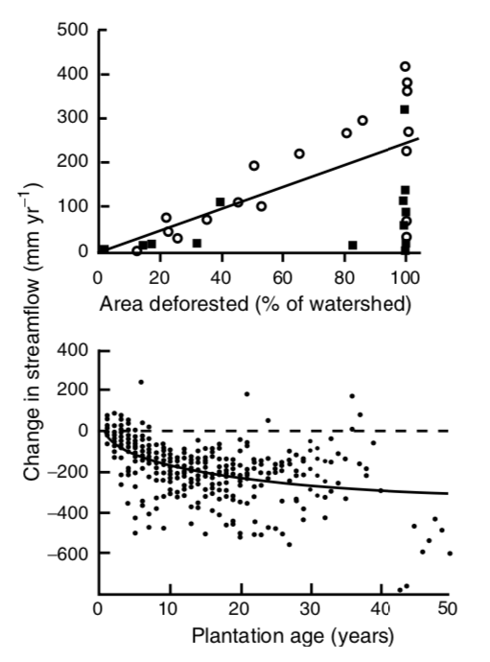
What’s happening here?

Slide 57
Final point: you cannot disentangle energy balance from water balance

